Slide 1

EXPLORING REGENERATION IN SUSTAINABILITY Understanding the vital role of regeneration in sustainability and its impact on agriculture and organizations
Under the Guidance of: Prof. Boris Lebedev Presented by: Aishwarya Lakshmi KB
Bhuvanesh H

Slide 2
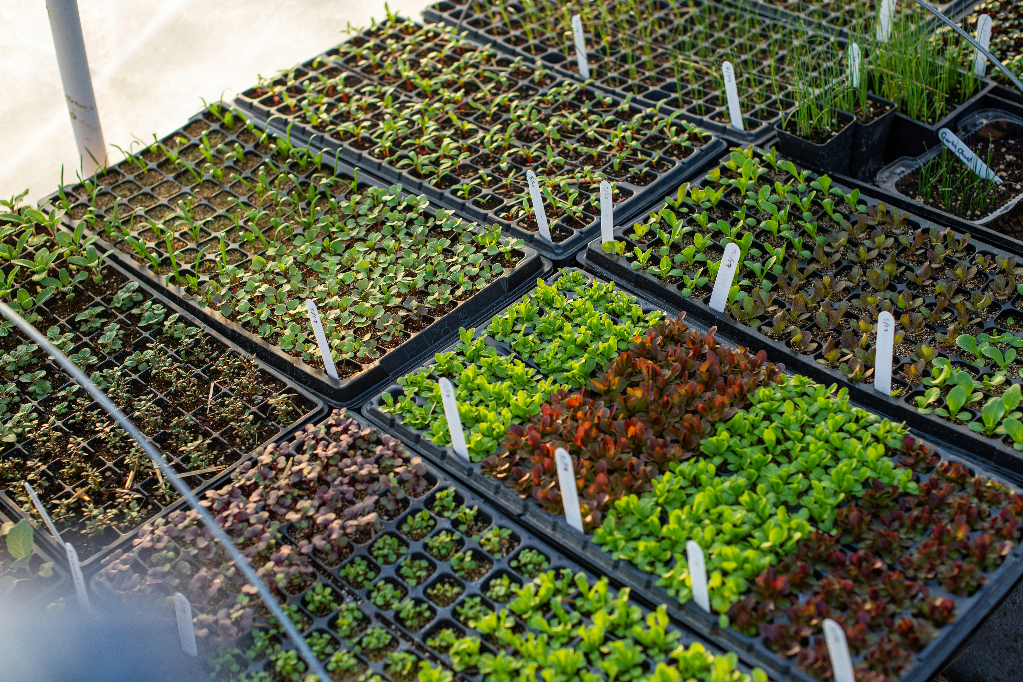

Topics Covered
Definition of Regeneration? Explore the key principles of regeneration.
Comparison with Sustainability Discuss the differences between sustainable practices and regenerative approaches in agriculture.
Visual representation from Sustainability to Regeneration Understanding why sustainability is not the long-term answer
Regenerative Practices in Agriculture Examine specific practices implemented in regenerative agriculture, such as cover cropping and agroforestry.
Case Study: Analyzing the innovative strategies employed by Gut&Bösel to achieve profitability while promoting ecological health.
Conclusion:

Slide 3
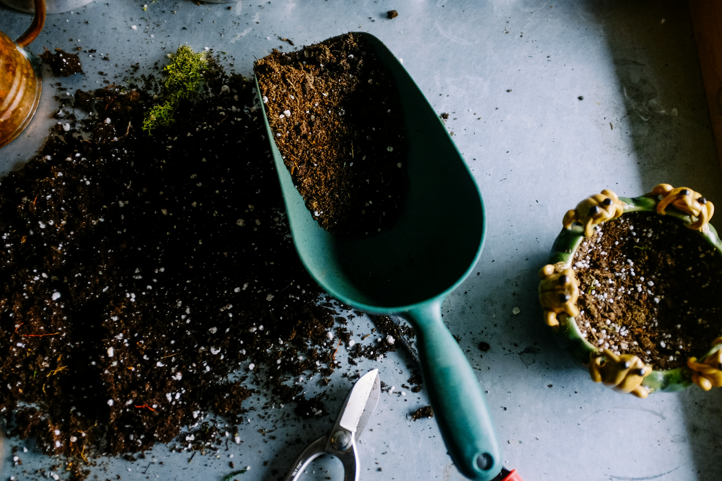
Definition of Regeneration
In terms of Nature - regeneration refers to the process by which living organisms restore or regrow lost or damaged parts, or in some cases, create new individuals from parts of the original organism.
A regenerative business is a company that aims to create a positive impact on the environment, society, and people by regenerating the resources it uses.

Slide 4
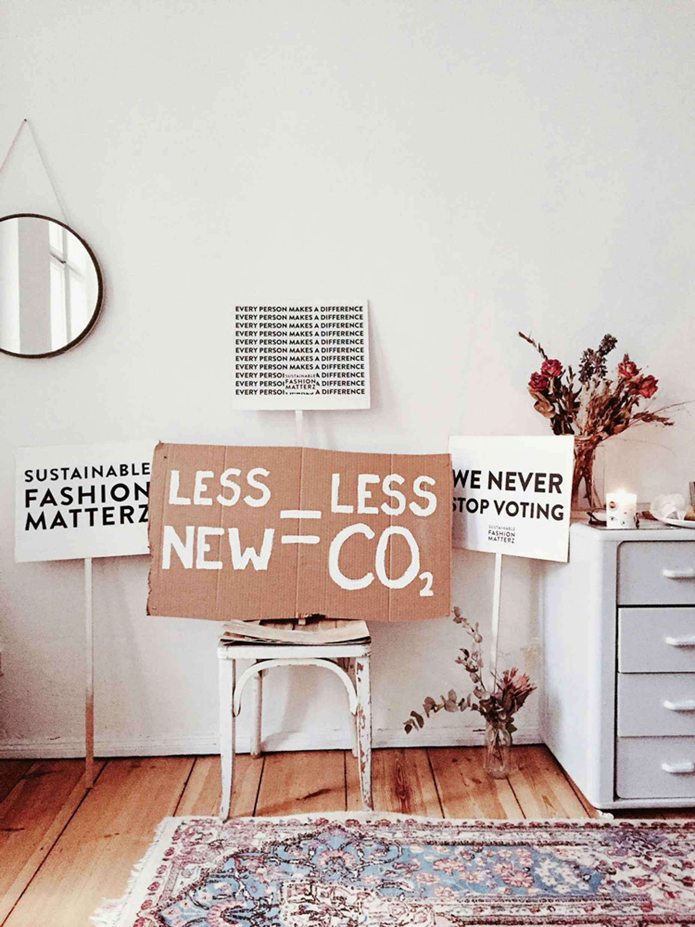
Difference Between Regeneration and Sustainability
Regeneration
Aims to restore and enhance ecosystems
Focuses on reviving and rebuilding natural systems
Supports proactive environmental improvements
Encourages biodiversity and ecosystem resilience
Seeks to create a positive impact on nature
Sustainability
Focus on maintaining the status quo
Emphasizes reducing harm to the environment
Often seeks to minimize negative impacts
Aims for long-term viability of resources
Primarily reactive to environmental issues

Slide 5

Visual representation from Sustainability to Regeneration
Planetary Health
New Balance
Resilience
Resilience
Degeneration
Regeneration
Sustainability
Vulnerability/ Collapse
Status Quo
Time

Slide 7


Slide 8
